Slide 1




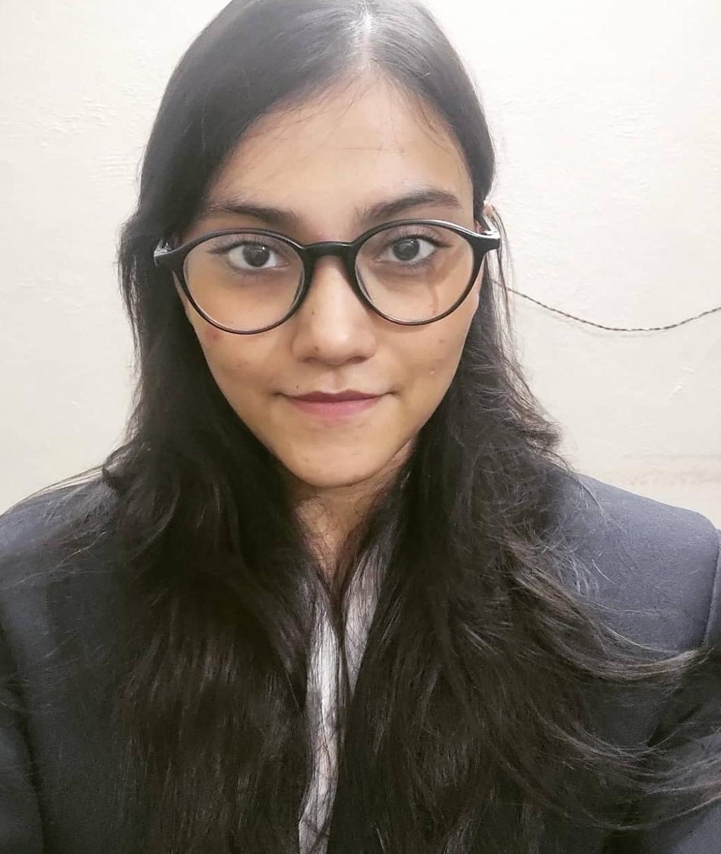
The Coffee Tales Dethroning the King?
Team SORTED
Devesh Sinha Mohit Kiradoo Kajal Gupta
T. A. Pai Management Institute

Slide 2




CONSUMER PERSONA
TIM HORTONS vs STARBUCKS
ACQUIRING CUSTOMERS
MARKET ATTRACTIVENESS & MARKETING MIX
PROMOTION STRATEGY
PERSONA 1
PERSONA 2
PERSONA 3
PERSONA 4
PROFILE
Vivek Bharati
Age: 27
Profession: Graphic Designer
Income: 60k per month
Saumya Sinha
Age: 20
Profession: Student
Raunak Ray
Age: 36
Profession: Marketing Strategist
Income: 85k per month
Shobha Thakur
Age: 44
Profession: High School Teacher
Income: 50k per month
Introvert
Extrovert
Introvert
Extrovert
Introvert
Extrovert
Introvert
Extrovert
PERSONALITY
Analytical
Creative
Analytical
Creative
Analytical
Creative
Analytical
Creative
Passive
Active
Passive
Active
Passive
Active
Passive
Active
Price
Price
Price
Price
MOTIVATION
Comfort
Comfort
Comfort
Comfort
Convenience
Convenience
Convenience
Convenience
Speed
Speed
Speed
Speed
Wakes up late in the morning
Orders breakfast online
Takes lunch during meeting in a café or a restaurant
Enjoys chai sutta with friends
Has maid for cooking and household chores
Sleeps late but wakes up early
Gets ready to rush to class with a cup of coffee
Spends evening with friends
Sits for studying at night making a call at home
Netflix for refreshment before going to bed
Wakes up early, goes for a walk
Client time begins after lunch
Reaches home at 7:30pm and cooks dinner
Scrolls through inbox before going to bed for client updates
Spends weekends with wife in café as both are coffee lovers
Wakes up early to cook breakfast for family before leaving for work
Rushes for coffee after every other class
Consumes 5-6 cups per day on average
Spends some time with family after reaching home at 5:30 pm
A USUAL DAY IS LIKE…
Café not for coffee but to work in distraction free environment
Wants charging point, cannot imagine a day without internet
Coffee lover, visits cafes on weekends
Free and unlimited wifi, for assignments and movies
Adventures and new experiences
Social media engagement
Experience of enjoying coffee
Doesn’t find CCD or Starbucks attractive as its noisy and crowded
Needs little privacy
Always in rush for quick and convenient ways to refresh
Consumes coffee to keep energised
Frequently goes to cafes
Needs silent atmosphere
LOOKING FOR..

Slide 3

CONSUMER PERSONA
TIM HORTONS vs STARBUCKS
ACQUIRING CUSTOMERS
MARKET ATTRACTIVENESS & MARKETING MIX
PROMOTION STRATEGY
TIM HORTONS
STARBUCKS
KEY POINTS OF DIFFERENTIATION
Understanding the customer needs and preferences
Who are the Customers?
People looking to grab coffee and head to work
People looking to sit and work in an environment
QUALITY
Unique brewing process for each cup of coffee; also serves home style cooked dishes like sandwiches, wraps, etc
Customer Reviews:
What do they want?
Quick and easy service
A cup of coffee made precisely to their specifications
Priority
Fast order delivery
Order accuracy
SERVICE INTERACTIONS
What makes their offerings unique?
-Made with high quality beans, roasted fresh daily and ground fresh for each cup
-Unique brewing process to create a smooth and rich cup of coffee
-Created a de-commoditized coffee space
-High quality beans
-Customer Experience and Service
-Highly-trained support staff
Low waiting time for customers(averages 5-7 minutes in non-peak hours and 10-12 mins in peak hours), functions as quick service restaurant
Customer Reviews:
Brand uniqueness
CUSTOMIZATION
-Iced Cappuccino
-Original Blend Double Double
-Caramel Latte Supreme
-Vanilla Cold Cream Brew
-Java Chip Frappuccino
-Pumpkin Cream Cold Brew
-Iced Brown Sugar Oat Milk Shaken Espresso
Low degree of customization, few products can be customized as per customer requirements
Customer Reviews:
Popular Beverages
PRICING
Menu Changes
Year-round consistent drink menu
Limited drinks every season
Pricing relatively lower(60-70% lower) in comparison to Starbucks and other coffee chains, follows a value pricing strategy
Customer Reviews:
Ambience
Lighting
Bright lighting
Moody lighting
Standard restaurant-style designed for small groups
Communal style to promote interaction
Which Persona currently goes where and who is likely to switch?
Seating
All the customer personas discussed are most likely to visit Starbucks because of its availability and the close-to experience they are looking for.
Persona 1, Persona 3 and Persona 4 are most likely to switch to other options, if provided a silent and distraction free environment.
What’s negative about them?
-“Hall of shame” for chemical use
-Mediocre product
-High sugar content
-Very expensive & mediocre product
-“Hall of shame” for chemical use

Slide 4
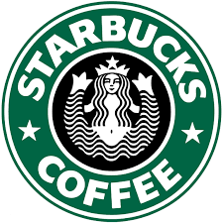
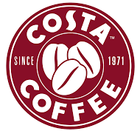
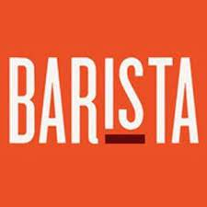
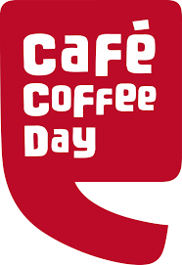
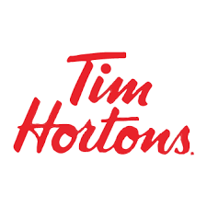
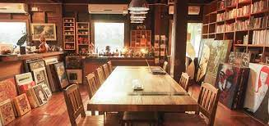
CONSUMER PERSONA
TIM HORTONS vs STARBUCKS
ACQUIRING CUSTOMERS
MARKET ATTRACTIVENESS & MARKETING MIX
PROMOTION STRATEGY
PERCEPTUAL MAP
CUSTOMER ACQUISITION
Based on online reviews, customer testimonials and secondary research, the two factors with high preference are service quality and price(affordability).
College Students
Use mobiles for everything
Impulsive shopping
Easily influenced by celebrities
Perceives Starbucks as relaxing comforting place to socialize
High association with Starbucks because of trendy image and consistency
Working Professionals/Family
Fast paced healthy lifestyle
Well educated and successful professionally
Frequently visits Starbucks for meetings and office work
High association with Starbucks because of image, experience and product
Expensive
Service Quality (Low involvement)
Service Quality (High Involvement)
Students might prefer a meeting place or library room or second working place with Wi-Fi
Many professionals are looking for silent atmosphere where they can work (rise of workcation)
The area of stiff competition among the coffee chain retailers. Other brands like Blue Tokai coffee Roasters and Third Wave Coffee are expected to be in this zone of competition.
Positioning the brand as a meeting place with limited capacity (60seats) to keep the crowd less
Affordable
Positioning | Meeting Place
Concept | Library & Meeting Room
Strategy | Second Working Place & Meeting Place
Emotion | Chilling place
Tim Hortons has earned good reputation in Canada and the United States. The service quality and the value pricing model of the brand has positioned it as a goto place for coffee amongst the Indians having Canadian acquaintances or have visited the store there.

Slide 5
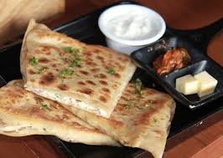
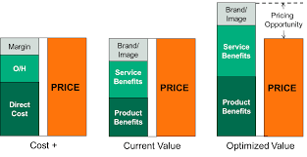
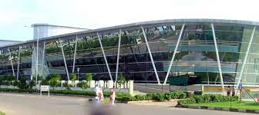
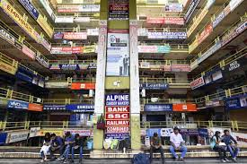
CONSUMER PERSONA
TIM HORTONS vs STARBUCKS
ACQUIRING CUSTOMERS
MARKET ATTRACTIVENESS & MARKETING MIX
PROMOTION STRATEGY
MARKET ATTRACTIVENESS
STRATEGIES TO BE IMPLEMENTED IN THE MARKETING MIX
The market size of retail coffee in India is estimated at Rs 1700 crore in 2022
Major players:
Café Coffee Day
Starbucks
Barista
Blue Tokai Coffee
Third Wave Coffee
PRODUCT
Along with their current menu, Tim Hortons should add parathas as breakfast menu which currently sandwiches, wraps, etc. As the company looks for expansion in the Northern part of the country, introduction of parathas as “home-made fresh food”, will likely to attract the younger population as well as the working class. Another recommendation, is to introduce coffee sachets for catering to the online RTD market through ecommerce channels. This is to create a buzz among the customers about the product, pushing trial purchase.
The market is expected to grow at a fast pace of over 20% in the recent times. However, the Indian Coffee retail chain market is estimated to touch $850 million by 2025
WHAT THE 5 FORCES SAY?
Large amount of substitutes
Supplier products are not differentiated from other supplier and are purchased all year round
Supply is not limited
Power of Suppliers:
Low
PRICE
To keep in competitive position as in North America, the prices should be kept lower compared to competitors (40%-50% lower). Cost of making each paratha is less than 10. Combination of it with additional items, and keeping a value pricing model would give margins as well as repurchases. Hence, a cost leadership strategy is recommended.
Product is undifferentiated but is offered at a lower price than key competitors
Industry attracts customers majorly in middle and upper income groups
Coffee and sandwiches can be home cooked
Power of Customer:
Low to Medium
Monopolistic market with few competitors
Competitors in the QSR category
Lack of product differentiation
Red Ocean Market
Existing Rivalry: High
PLACE
Being a mass segment brand, it should open its stores in proximity to shopping complexes, educational hubs and corporate parks for achieving high footfall. As it has started its operations in the Northern part of the country starting from Delhi, it should look further to expand in Tier-1 cities only. Delhi, Kolkata, Hyderabad, Bengaluru and Mumbai should be its high priority locations where the above criterions are fulfilled. Additionally, these stores should have a light mellow ambience giving a feeling of silent atmosphere. The look and design of the store should give an emotional arousal of a place similar to library or a second working place, suited for professionals. Airports can also be a potential place to attract commuters.
Undifferentiated products
Price sensitive
Power of Substitutes: High
Small economies of scale
Undifferentiated products, products differ in pricing
Large initial investment
Threat of new entrants: Low
With few players in the category, and major chunk of the market unaddressed, Tim Hortons has an opportunity to expand its dominating presence in India.

Slide 6
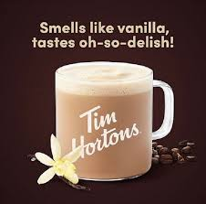
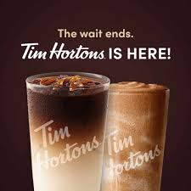
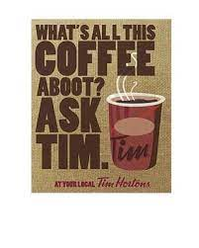
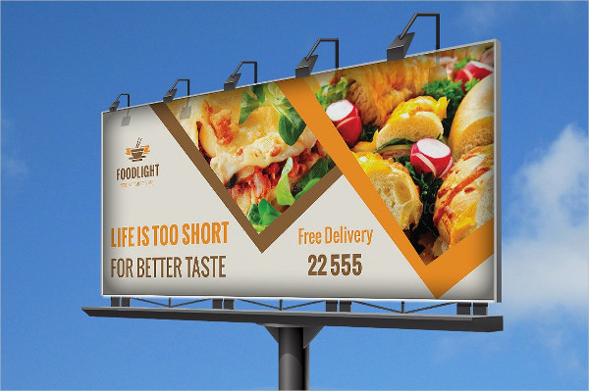
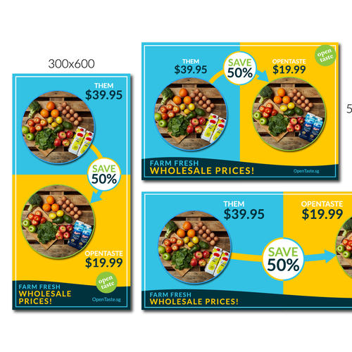
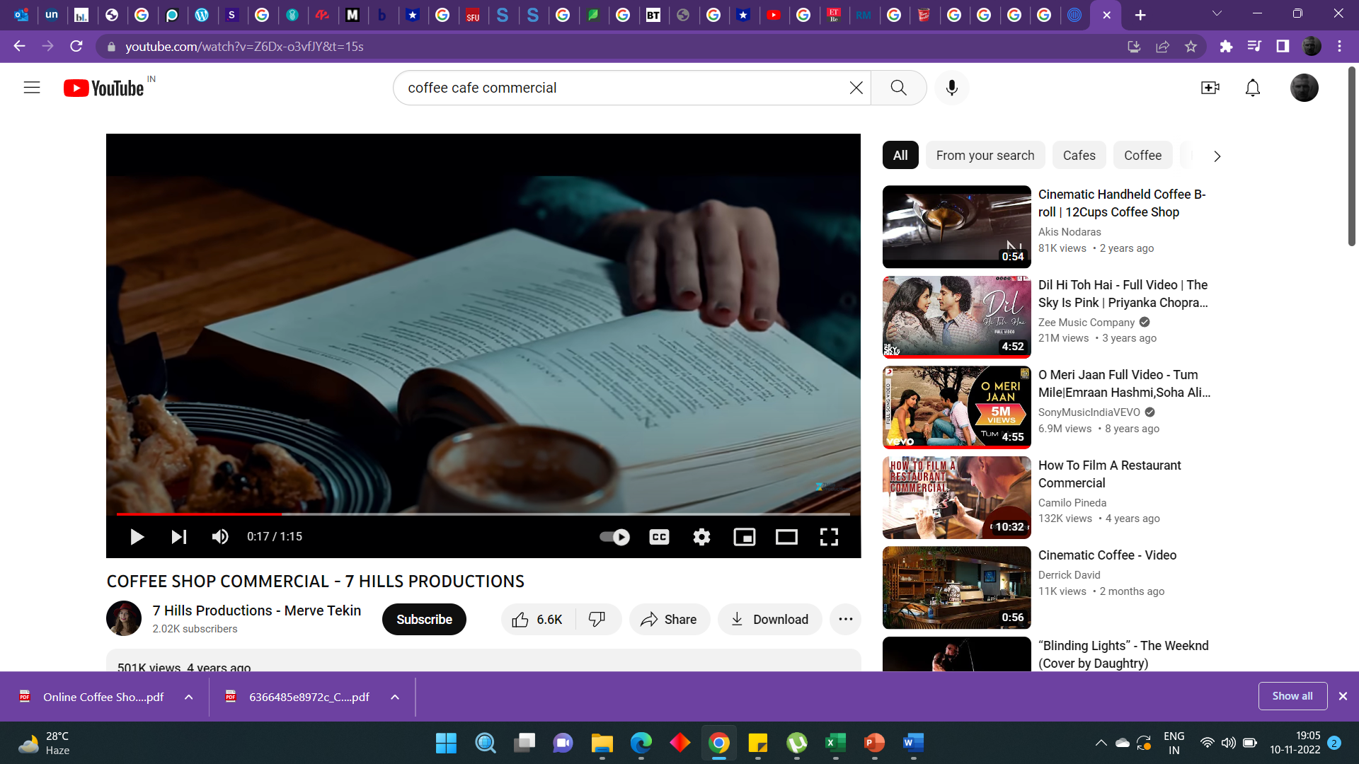
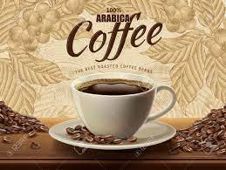
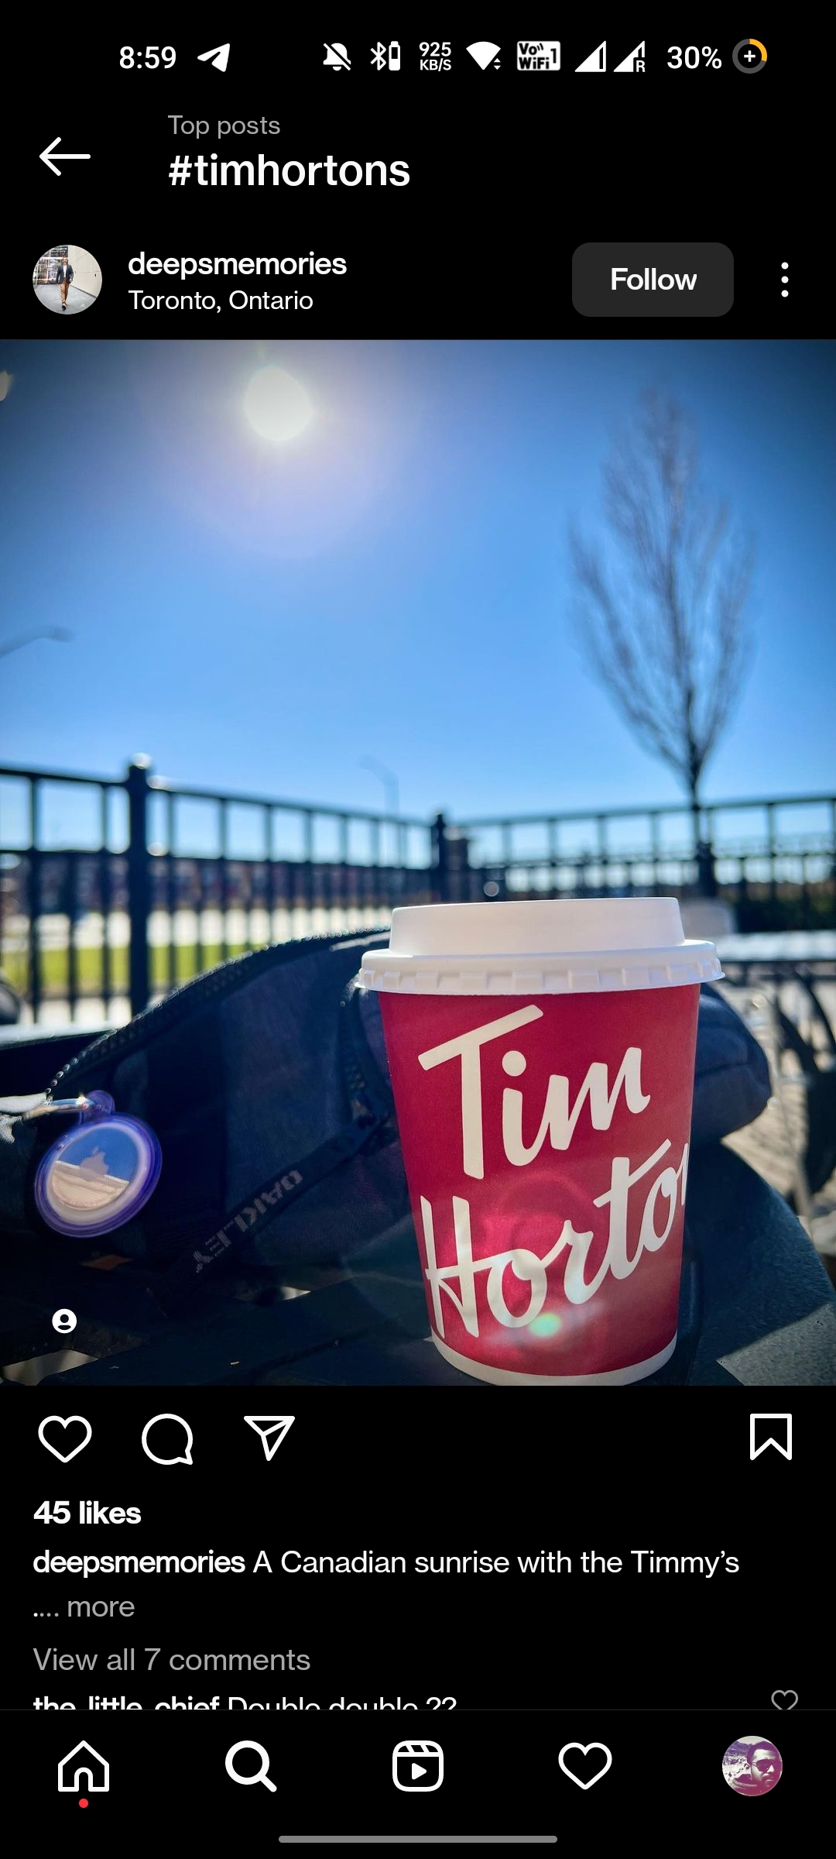
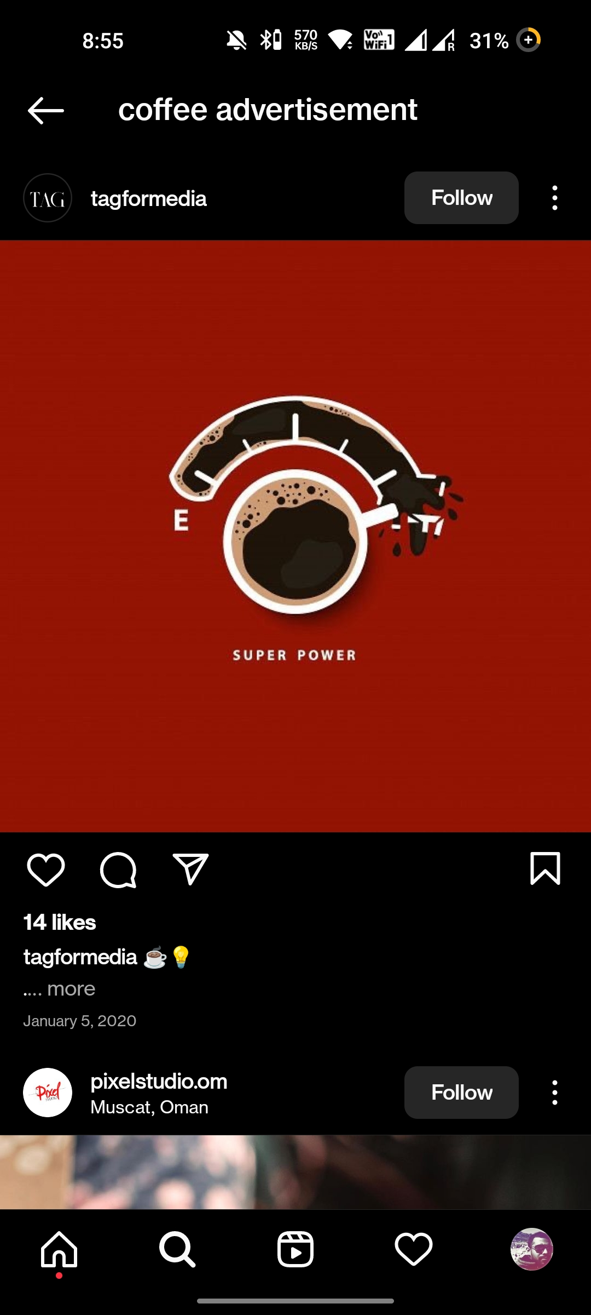
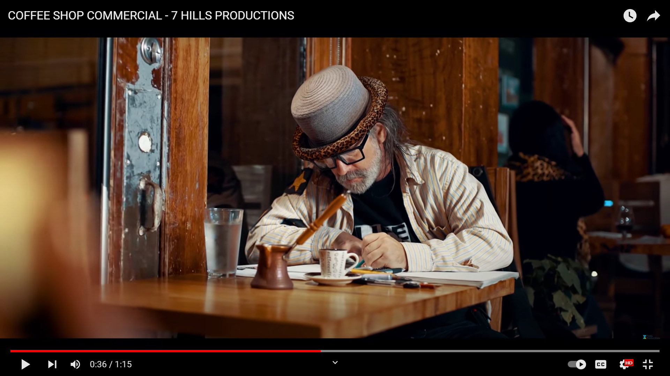


CONSUMER PERSONA
TIM HORTONS vs STARBUCKS
ACQUIRING CUSTOMERS
MARKET ATTRACTIVENESS & MARKETING MIX
PROMOTION STRATEGY
PROMOTION
This plan will use an integrated mix of billboards, commercials, print media in newspapers, Instagram reels and posts. The promotion campaign will take place over a full year span, from Nov ‘22 to Oct ‘23 in order to increase awareness to the point where customers associate breakfast/brunch with Tim Hortons. (References beside)
1. Billboard
3. Print Advertisement
Objective: For maximum reach to the target audience which includes students and professionals, who have long day out.
Place: In primary business district of the city, near traffic signals and highways connecting to the city where their stores are present.
The ad: Coffee promotion, healthy place for breakfast/lunch and new introductions
Objective: Communicating the universal uniform message, “Tim Hortons is every man and every woman”, to drive call to action
Place: Times of India(mass), BusinessLine(working), and regional newspapers(mass); store openings advertisements to feature on the front page
The ad: Promotions of store opening, introduction of new items and price comparison to induce call to action
2. Commercials
4. Instagram
Objective: In order to integrate other marketing endeavours, will attempt to attract the target audience, specifically Starbucks customers.
Place: A national advertisement across major channels(big event media channels like Star Sports and Sports 18 hosting world cup telecast)
The ad: A 30-sec commercial arousing emotions of having breakfast and working in a library-like environment, to attack the psychographic of individuals
Objective: To drive engagement among the younger population and extend visibility
Posts: Promotion of 100% arabica coffee beans, price comparison creatives, and through its official page
Reels: Through influencers to increase reach and promote it as recommended place for working and having breakfast to initiate trial purchase
Hashtags: #TheMorningCoffee, to drive engagement among the social media buffs
#TheMorningCoffee
Nov | Dec | Jan | Feb | Mar | Apr | May | Jun | Jul | Aug | Sep | Oct
Print advertising
Click here for Appendix
Billboards
TV Commercials
#TheMorning Coffee
Engagement posts, reels
Tim Hortons should continue to position itself as a second working and meeting place, and focus on its strength, high-quality fresh food and 100% arabica coffee with an additional perception of a ‘Breakfast joint’. Getting into chai café culture should not be its priority as its strength has been coffee and low pricing of its food and beverages.

